Slide 1
Chapter 8
Data Modeling
Part 2

Slide 2
Building the
Logical Data Model
1. Context Data Model
2. Key-Based Data Model
3. Fully Attributed Data Model
4. Normalized Data Model

Slide 3
1. Context Data Model
Include the fundamental entities as well as their natural relationships
Name relationships with verb phrase that, when combined with the entity names, form simple sentences or assertions.
Proceed from parent entity to child entity

Slide 4
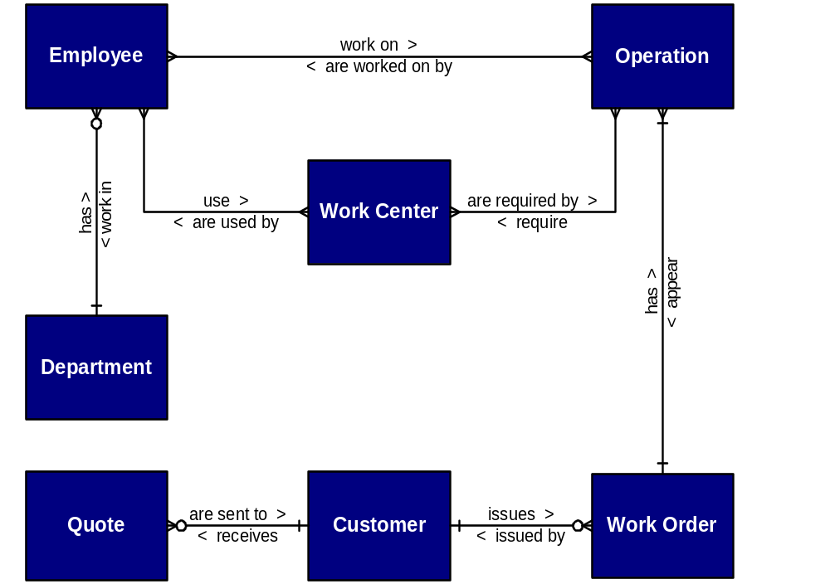
Context Data Model

Slide 5
2. Key-Based Data Model
Keys
Codes
  Serial
  Block
  Alphabetic
  Significant Position
  Hierarchical

Slide 6
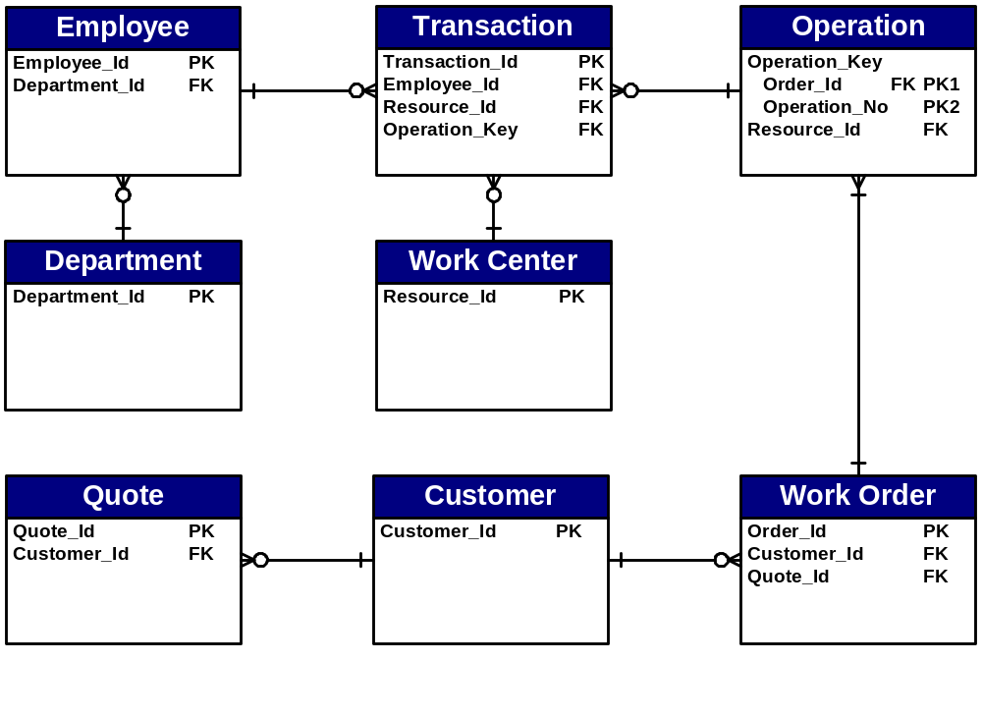
Key-Based Data Model

Slide 7
3. Fully Attributed Data Model
Naming standards
Distinguishable names
Clear attribute names
Consistent data types, domains, and defaults
Each attribute mapped to single entity

Slide 8
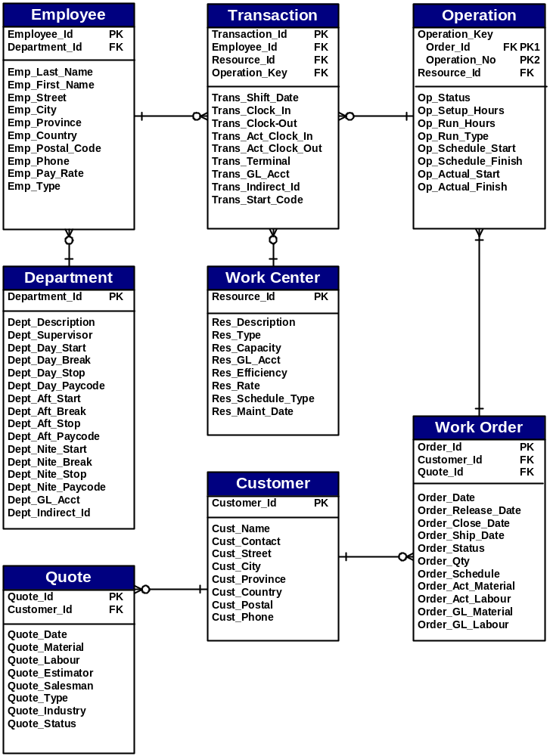
Fully Attributed Data Model

Slide 9
4. Normalized Data Model
First Normal Form (1NF)
  attributes are not repeated
Second Normal Form (2NF)
  1NF and attributes are dependent on full primary key
Third Normal Form (3NF)
  2NF and attributes not dependent on any non-key attributes

Slide 10
Normalization
A data analysis technique to improve a data model for implementation as a database, that organizes data into groups to form entities that are:
    simple
    non-redundant
    stable
    flexible & adaptable

Slide 11
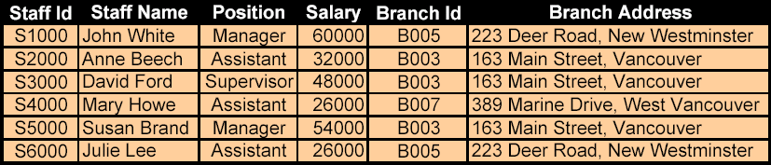
Unnormalized Example
Redundancy
Insertion Anomalies
Deletion Anomalies
Modification Anomalies

Slide 12
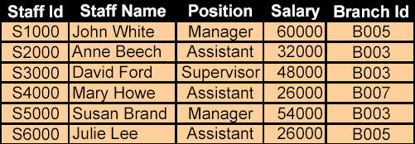
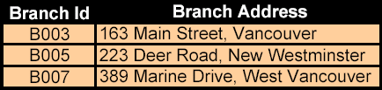
Normalized Example

Slide 13
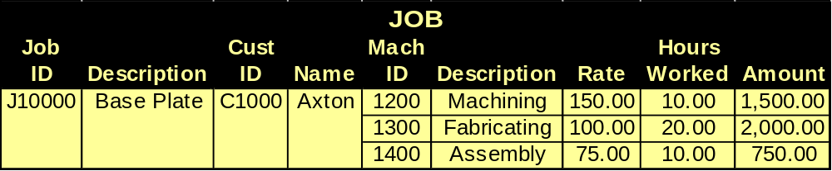
Unnormalized Form (UNF)
An entity with attributes that contain repeating values for a single instance of that entity

Slide 14

ERD in UNF

Slide 15
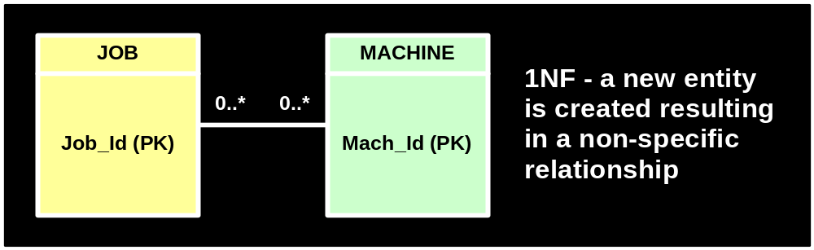
ERD in 1NF (step 1)

Slide 16
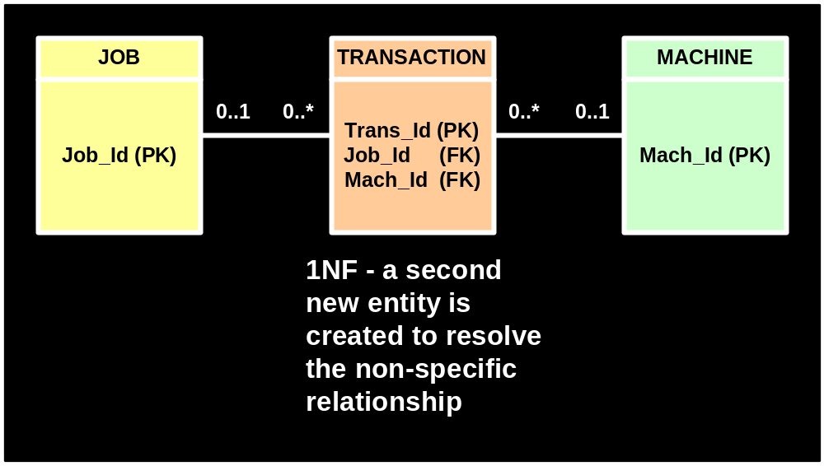
ERD in 1NF (step 2)

Slide 17
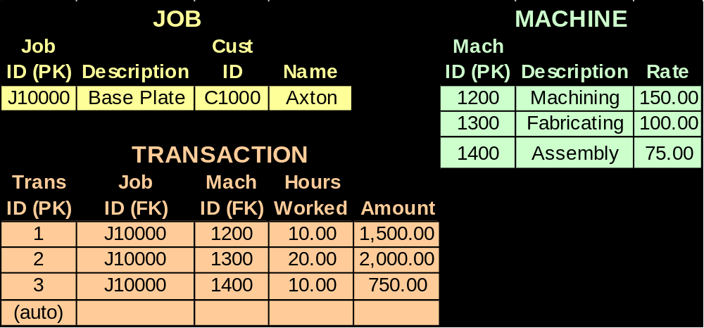
1st Normal Form (1NF)
An entity whose attributes have no more than one value for a single instance of that entity

Slide 18
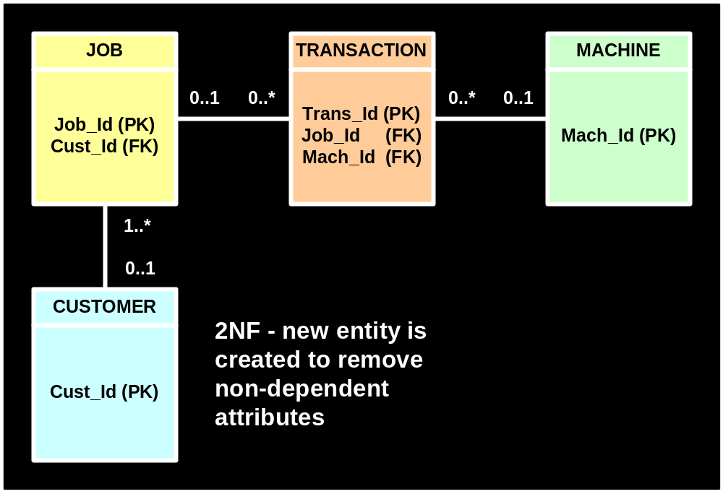
ERD in 2NF

Slide 19
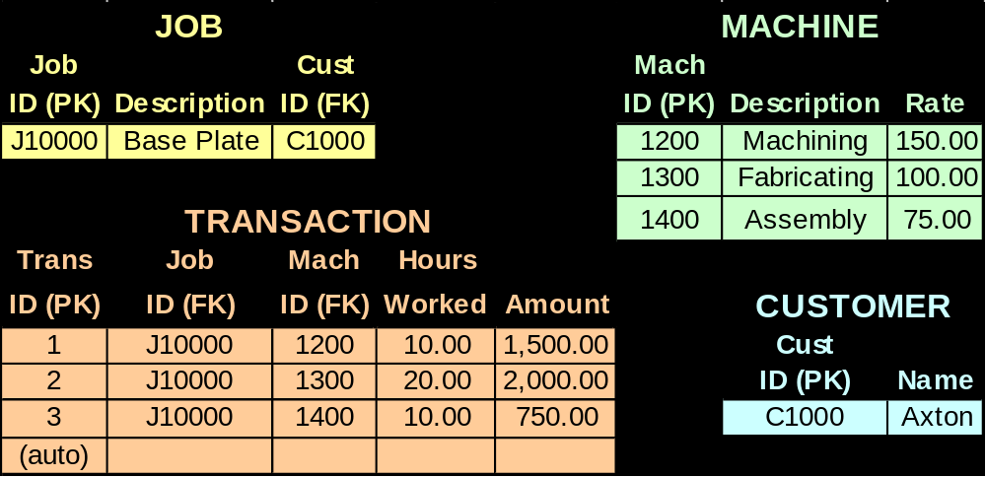
2nd Normal Form (2NF)
An entity whose nonprimary-key attributes are fully dependent on the primary-key

Slide 20
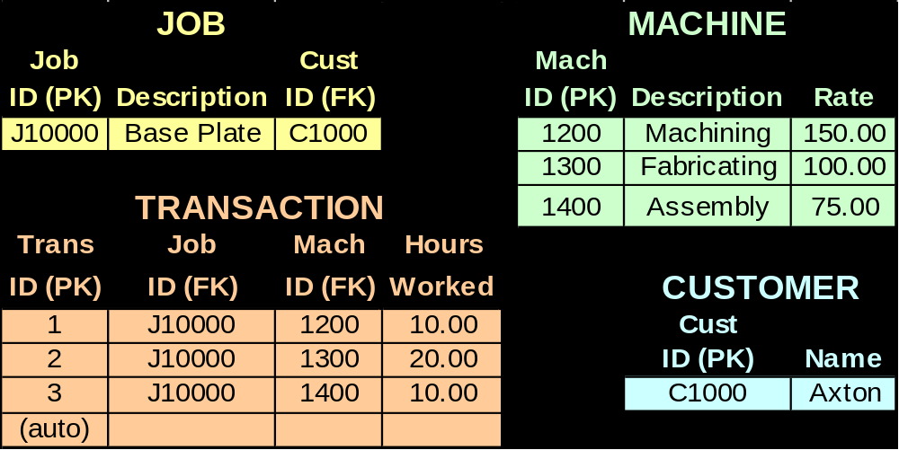
3rd Normal Form (3NF)
An entity whose nonprimary-key attributes are not dependent on any other nonprimary-key attributes

Slide 21
A Good Data Model
Simple
Non-redundant
Flexible and adaptable

Slide 22
Mapping Data Requirements
Create new instances
Read instances
Update existing instances
Delete instances

Slide 23
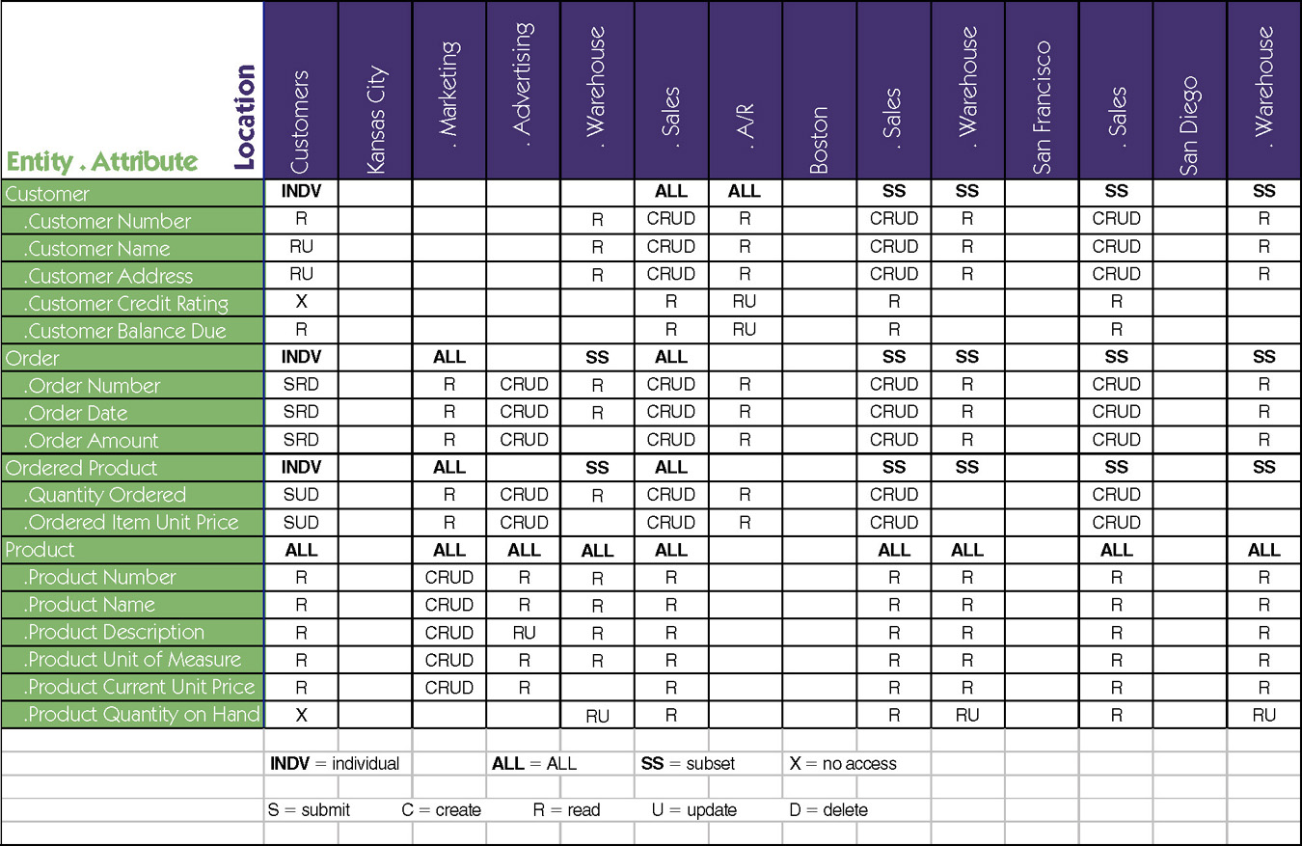
Data-to-Location-CRUD Matrix
Notes:
No additional notes

Slide 24
End of Part 2

